Slide 1
McDonald’s Corperation
Task for Business Insights Analyst
Applicant Name : Jun Poh
Date : 25/11/2022

Slide 2
Objective
Key Stake Holders : Head of Consumer Insights / Head of Business Insights and Analytics
Scenario : Bank X is McDonalds POS terminal service provider. Bank X had a network outage on 15/4/2022 between 9.15pm – 4 am which might have impacted total sales. The business wants to understand the potential impact on total sales caused by the network outage.
Task : Investigate the sales data, to identify estimated impact on sales during network outages, and present insights that could be of interest to the business.
Datasets Range : 2 Data tables is provided for the whole month of April from 1st of April to 26th of April 2022
Tools Used : Microsoft PowerBI

Slide 3
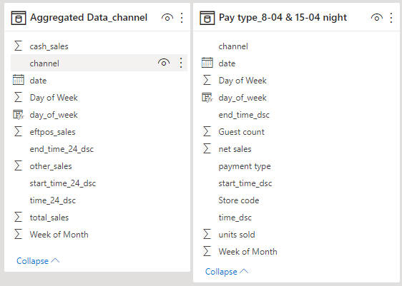
Data Provided
Data consist of 2 tables, with information on aggregate of sales in 15 minutes interval during April.
Table 1 consist of each sales within the 15 minutes interval across different channels of sales e.g. Delivery, Drive thru etc.
Table 2 consist of the cut of sales on the 8th and 15th April for a specific time window by various payment types and sales channel by store code.

Slide 4
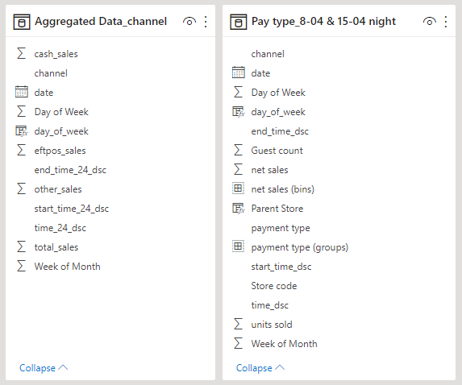
Data Transformation
The data is extended and manipulate to easily carry out the analysis and find insights, the manipulation and transform consist of :
Break down of date to different weeks of the month and days of the week in April
The 15 minute interval been broken down to two columns.
Grouping payments types and bin net sales, to help easily visualise the results and impact.

Slide 5
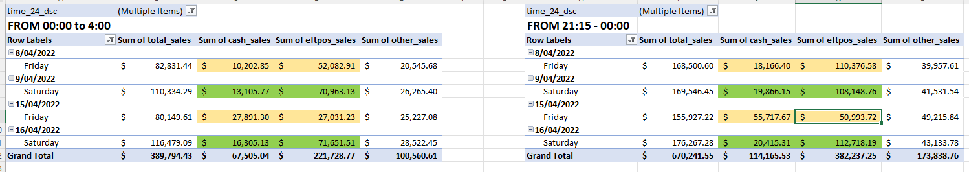
Overview Insights
Given the context of the scenario you would need to analyse how the effect of network outages affect McDonald’s sales performance.
The cost of the incident happens on the 15/04/2022, between 9:15pm to 4am, which falls on a Friday.
At 12am midnight, we know that it carries over to 16/04/2022 and have noticed that the sum of sales, cash and EFTPOS does not change much the outage.
This can be deduce that the system might have a cut off period where it refreshes the information overnight and might consider the business information from 12am to 4am to be part of 15/04/2022.
We can see that the change at 12am to 4am on the 15/04/2022 in EFTPOS and Cash sales on the data.

Slide 6
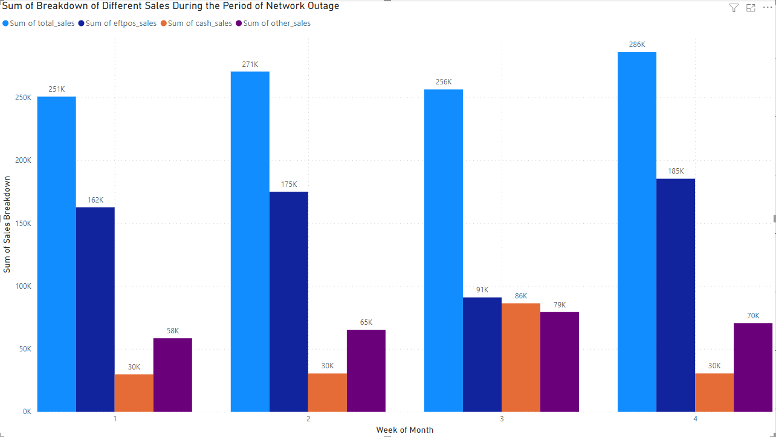
Overview Insights
Given the context of the scenario you would need to analyse how the effect of network breakdown affect McDonald’s sales performance.
The incident happens on the 15/04/2022, between 9:15pm to 4am, which falls on a Friday.
By filtering based on the conditions above to focus on the problem at task, the x-axis are filtered to represent every Friday of the week between 9:15pm to 4am.
We can observed a significant decline in the EFTPOS sales and an increase of CASH sales for an approximate 50% from week 2 to week 3, this shows that the network outage for bank X affect the EFTPOS sales.
Overall on the total sales, there isn’t much impact to the overall business, as from the 2nd to 3rd week there is a small decline of approx. 5.5% of sales drop, while on the 4th week there is a 11% increase from the 3rd week.

Slide 7
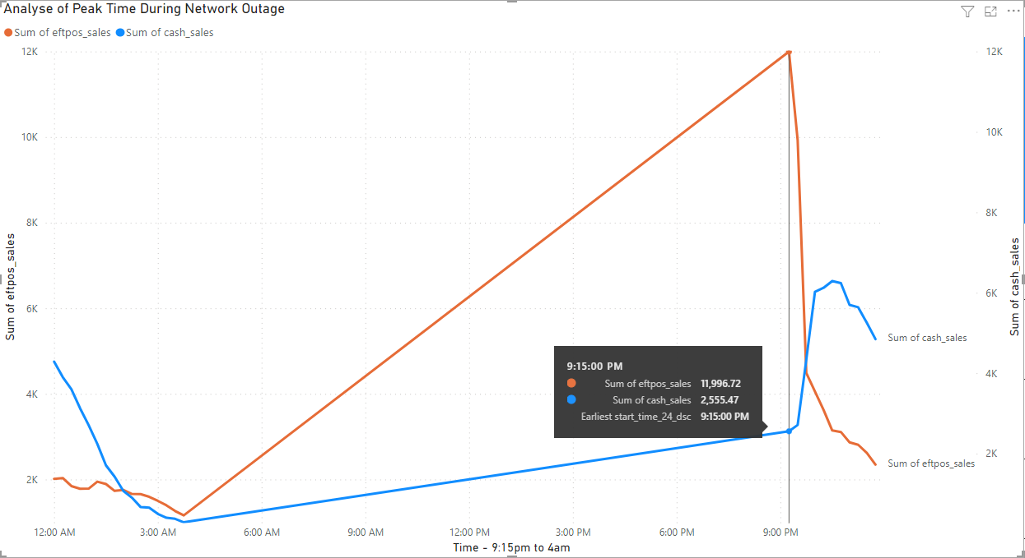
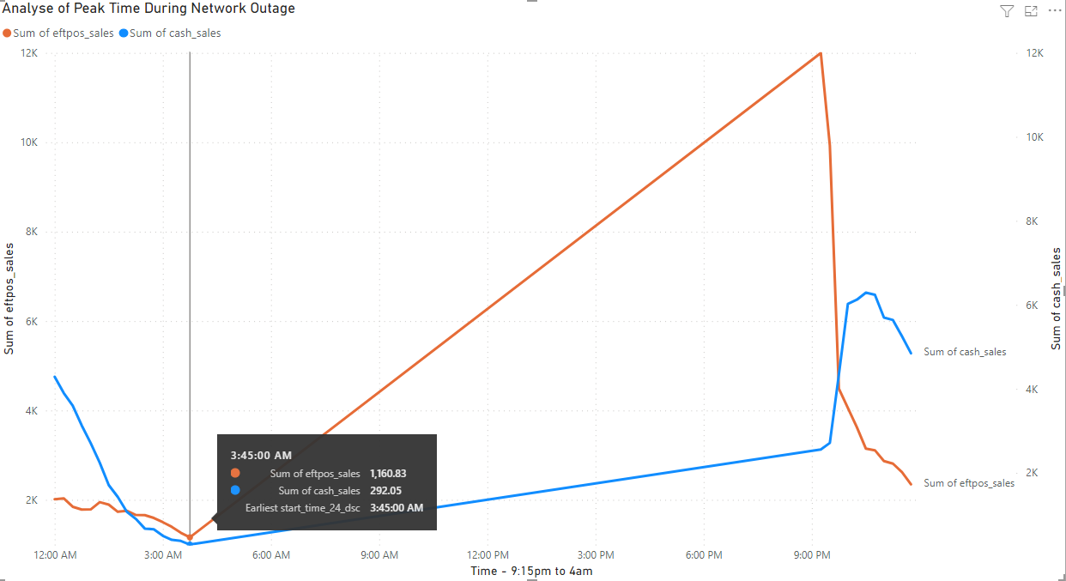
Analyse of Peak Time Usage During Network Outage
A time series line graph is shown between the two EFTPOS sales and CASH sales to understand the peak time the incident occur during the outage.
We can confirm that at 9:15pm we notice a significant drop in sales for EFTPOS, causing the CASH sales to increase in sales sharply.
The incident ended at 3:45am to 4am where we can see that EFTPOS sales increase back to normalisation, indicating the Network Outage has been resolve.

Slide 8
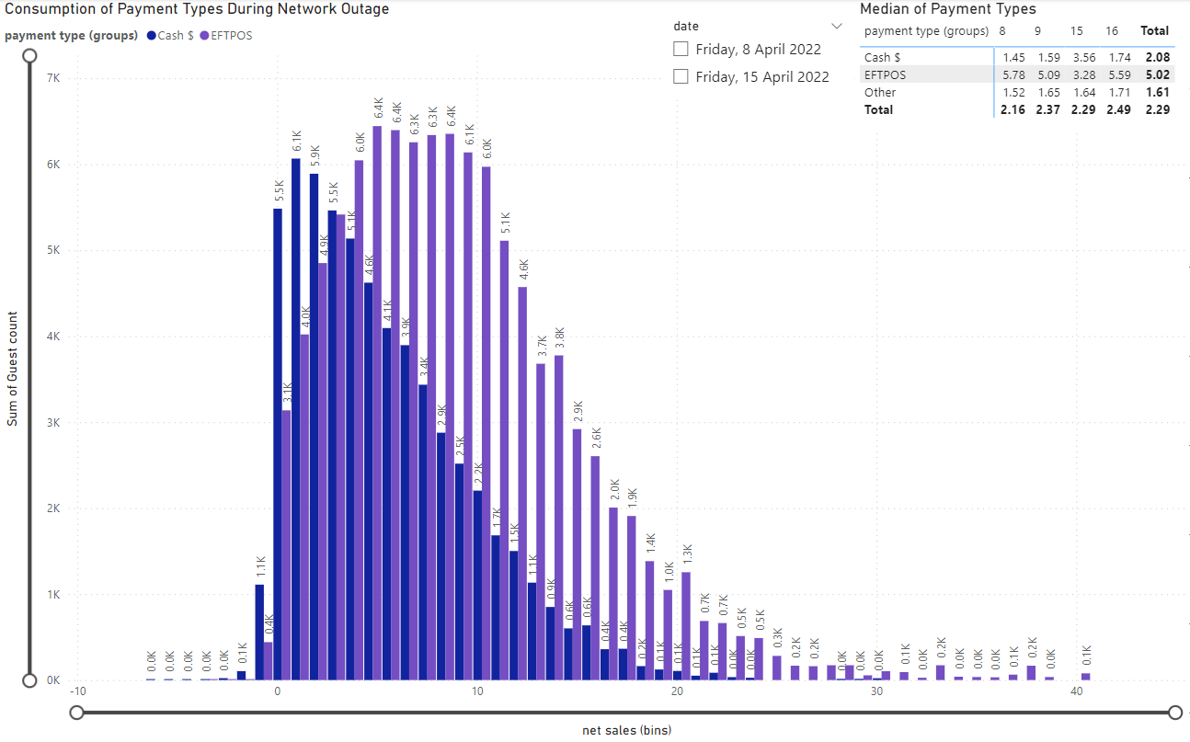
Impact of the Sales During Network Outage
On the second table “Pay type_8-04 & 15-04 night” we can understand how the consumption of Cash and EFTPOS performs during the outage compare to the 8th of April on a Friday.
We can see overall on Friday 8th and 15th the use of EFTPOS are most favourable among the public, this is due to the fact that customers prefer cashless payment method.
In summary, the median spent of the population during the two days is 7.1 dollars spend per unit of guest count.

Slide 9
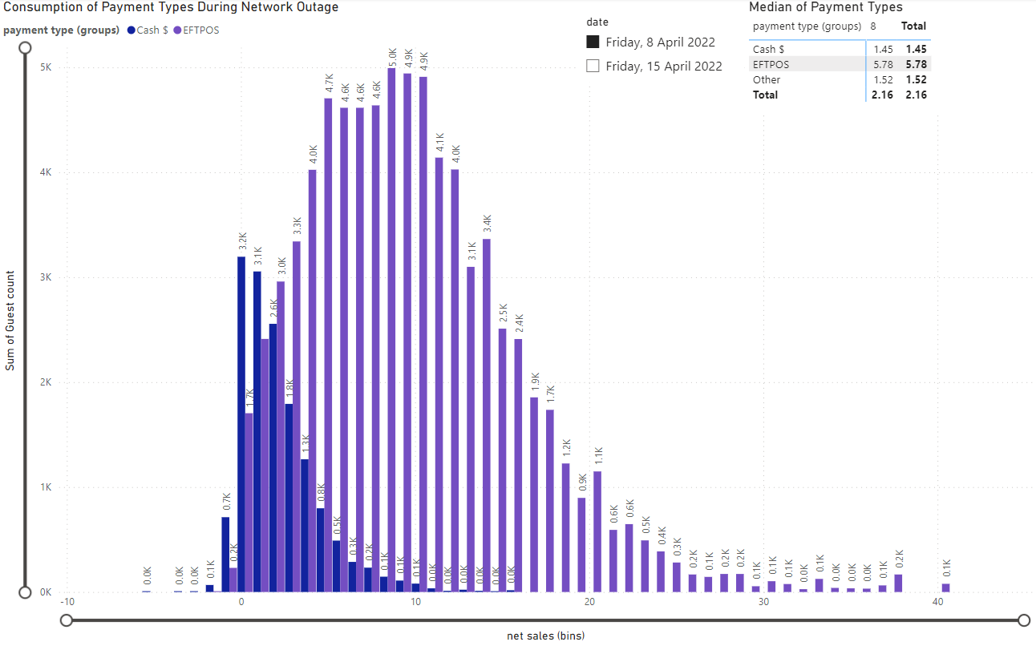
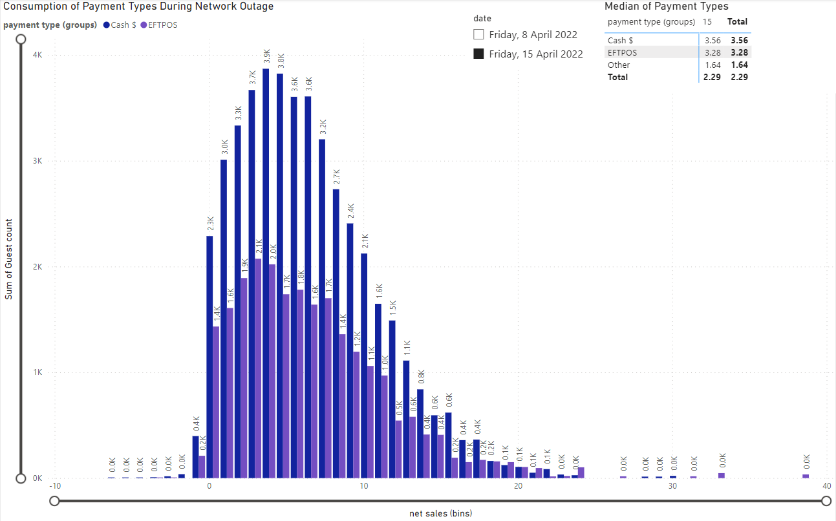
Comparing the Sales during Sales Outages and Normal Operations
Friday the 8th of April Sales
Friday the 15th of April Sales
We can observed the two distribution charts above, the change of distribution of Cash payments and EFTPOS. From left to right chart, we can observed that EFTPOS payments distribution have shifted to the left with from a median of 5.78 to 3.28 dollars per guest.
If we calculate the total of Cash and EFTPOS sales median we are losing 0.39 dollars per unit of guest, causing a potential lost on net sales of 21.35K between the two days.

Slide 10
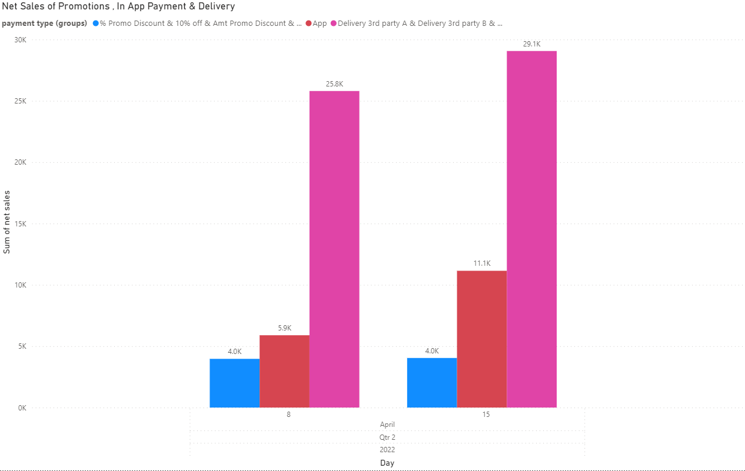
Strategies to consider to reduce the impact of Network Outages
Strategies to consider to reduce the impact is to look at other channels of payment methods.
We can see that although EFTPOS sales has been decreased between the 8th and 15th of April, other channels like In-App payment and delivery have increase slightly.
Promoting or encouraging more customers to use the In-App payment or deliveries may reduce the impact of sales, as the network outages may only be specific on a specific network, and customers may have other alternative to make payment for food.

Slide 11
Any other recommendation to consider & Challenges
Recommendation to consider for the analysis to improve insights can be considered by the following:
Adding meal items to the datasets to understand purchasing behaviour of customers during the outages.
Location features to understand which stores have given an impact to the sales of the network outages.
More historical data, of network outage or different accidents that has occurred historically to analyse the accidents and what precautions has been taken to minimize the risk of impact.

Slide 12
Summary to the Key Stake Holders
Overall, the impact of total sales are not huge and this can be taken account the affects of trends and seasonality of sales.
We can know that the network outages has an affect to the payment of EFTPOS systems.
The impact of sales between cash and EFTPOS are vice versa, usually population prefers for cashless payments, however when network outages occur they will still resort to using cash payments, but the amount of spending per unit will slightly decrease.
Other alternative of payment methods can be promoted, such as more promotion on the Macca’s app to encourage users to use the app for in-app payments for food purchases, or resort with delivery partners to help reducing the impact of sales.

